Slide 1
Building Secure ML Pipelines at Scale
for Agentic Workflows with RAG
Muntaser Syed • May 7 2025

Slide 2
Agenda
Why RAG + Agentic Workflows?
Threat Landscape & Security Risks
Secure Pipeline Architecture
Scaling & Governance Strategies
Case Study & Best Practices

Slide 3
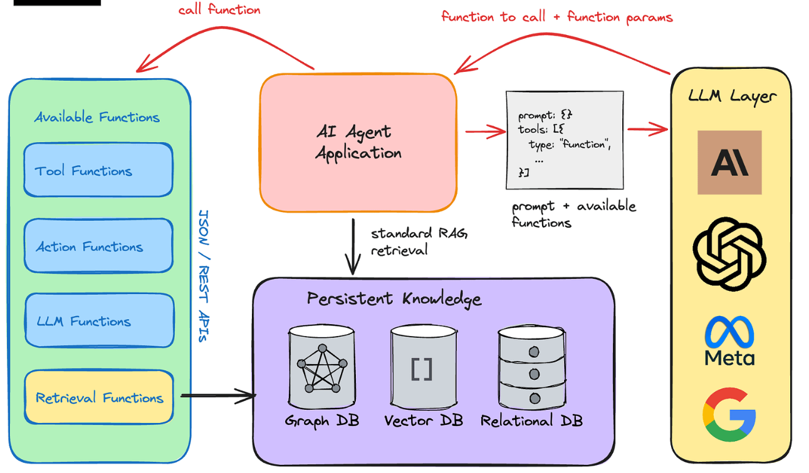
RAG & Agentic Workflow Primer
Retrieval‑Augmented Generation (RAG): retrieve domain context → generate answers
Agentic Workflows: autonomous orchestration—planning, tool use, memory
Synergy: agents decompose tasks, route to RAG sub‑pipelines, track state

Slide 4
Security Threat Landscape
Data leakage & ownership violations
Prompt injection and jailbreak attacks
Training‑time poisoning / supply‑chain risks
Unauthorized retrieval (broken ACLs)
Compliance gaps (HIPAA, GDPR, PCI)

Slide 5
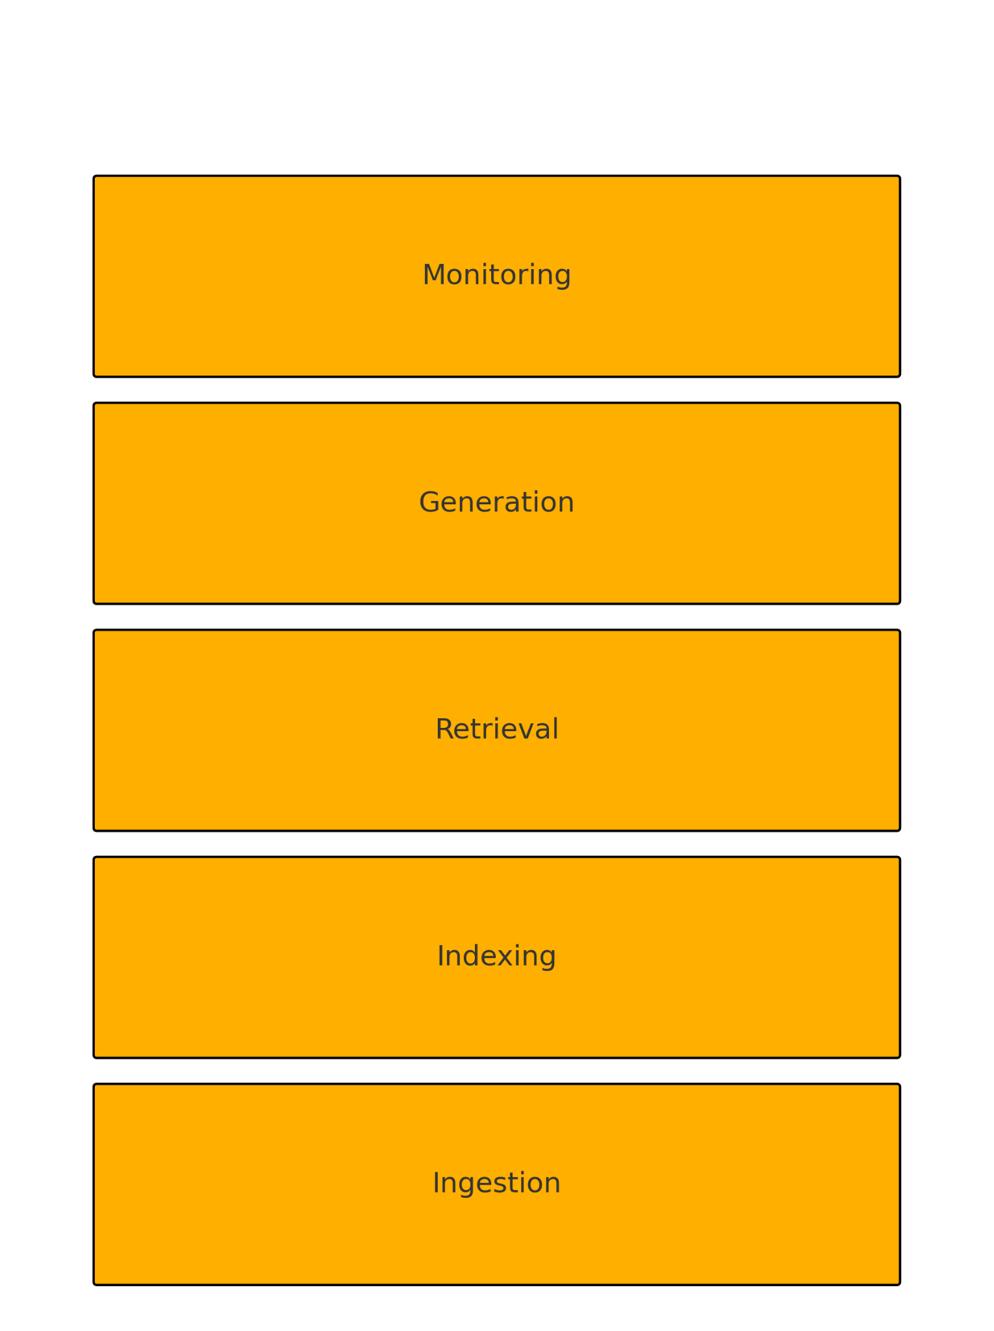
Secure RAG Pipeline Architecture
Ingestion: schema validation, malware scanning, DLP
Indexing: encryption‑at‑rest, row‑level ACL tags
Retrieval: policy‑aware vector DB (e.g., OpenFGA / Cerbos filter)
Generation: isolated runtime, output filtering & red‑teaming hooks
Monitoring: audit logs, telemetry, anomaly detection

Slide 6
Data Governance & Access Control
Attribute‑ & role‑based policies (ABAC/RBAC) enforced pre‑query
Cerbos | OpenFGA | Oso for declarative policy
User‑context embedding filters → least‑privilege retrieval
Audit trails integrate with SIEM & compliance reports

Slide 7
Privacy & Cryptography Techniques
Deterministic & order‑preserving encryption for vector IDs
Hybrid HE / DP for sensitive embeddings
Asymmetric envelope encryption on FHIR bundles (healthcare)
PII scrubbing & policy‑based redaction pre‑index
Secure enclaves / confidential VMs for LLM inference

Slide 8
Scaling Considerations
Stateless orchestration (Kubernetes, serverless)
Distributed vector stores: Weaviate, Milvus, Supabase Vector
Streaming pipelines (Kafka, Pulsar) for near‑real‑time updates
Edge caching & warm retrieval for latency‑critical agents
Cost controls: adaptive shard replication, tiered storage

Slide 9
Evaluation & Monitoring
LLM‑specific telemetry (latency, token use, drift)
Automated red teaming & synthetic adversarial suites
Secure eval frameworks (OpenAI Evals, RobustBench)
SLOs: hallucination rate, policy‑violation rate
Closed‑loop feedback for retriever quality

Slide 10
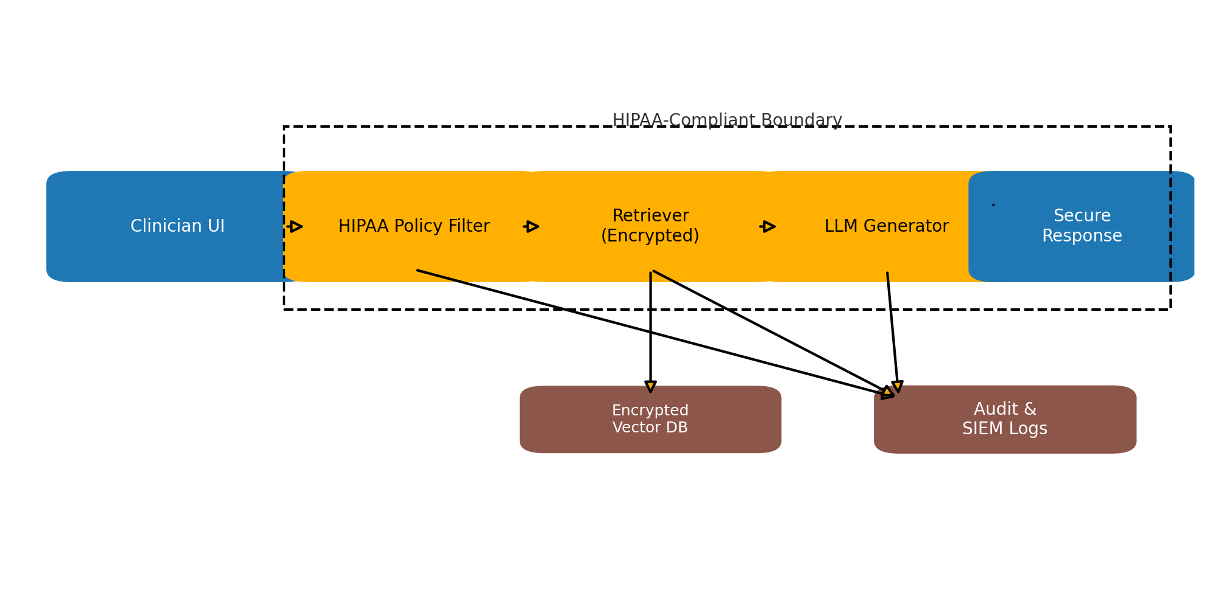
Case Study: HIPAA‑Compliant Clinical Agent
Use‑case: clinician assistant with EHR‑linked RAG
FHIR data → encrypted vector store w/ row‑level ACL
Agent filters queries via PHI policy, returns summaries
Audit events streamed to Splunk; anomalies trigger alerts

Slide 11
Best Practices Checklist
Threat model early; treat RAG like any data pipeline
Encrypt everywhere; separate keys from compute
Policy‑aware retrieval & generation guards
Automate testing, evaluation & incident response
Iterate with red teams; monitor continuously

Slide 12
Key Takeaways & Q&A
Secure foundations enable safe agentic autonomy
RAG adds new surfaces—govern them rigorously
Scalable patterns exist—use mature OSS & cloud controls
Continuous monitoring is non‑negotiable
Questions?

Slide 13
References & Further Reading
Cloud Security Alliance – Mitigating RAG Risks (2023)
Weaviate Blog – Agentic Workflows (2025)
Cerbos – Authorization for RAG Apps (2024)
Auth0 – Secure RAG with LangChain & OpenFGA (2025)
Protect AI – RAG Security 101 (2024)

